Slide 1
Getting Started with Git and GitHub

Slide 2

What you’ll need
This is a lunchtime computing seminar! As we proceed, you can follow along with the instructions and get some hands-on experience with using Git.
To start - go to http://github.com/ and create an account if you don’t have one already. Fill out the information about yourself in the profile.
You will also need to download Git.

Slide 3
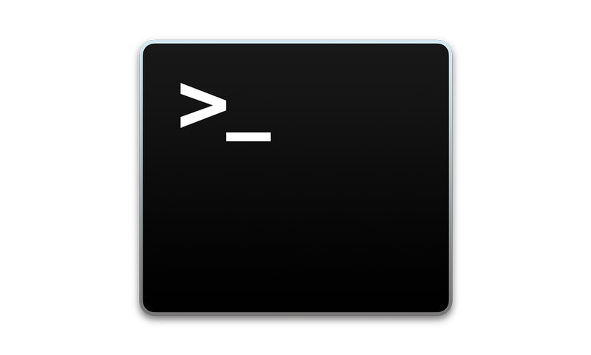
Installing Git
Git is software accessed through the command line / terminal / console / shell
For MacOS: open terminal and run git --version
For Linux: Visit https://git-scm.com/download/linux
For Windows: Visit https://gitforwindows.org/
Contains download, as well as GitBash, a special terminal making it easier to use Git
Notes:
https://git-scm.com/book/en/v2/Getting-Started-Installing-Git

Slide 4

What is GitHub?
GitHub is a software development platform
Three major aspects of GitHub:
Project organization and version control
Collaboration between programmers
Self-promotion

Slide 5
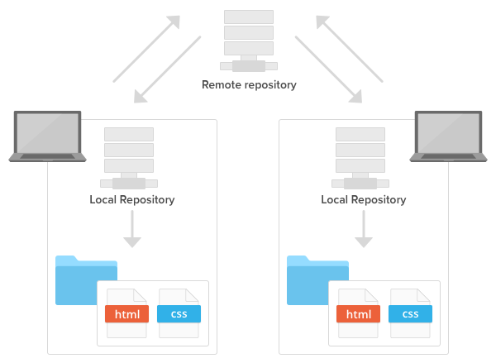
How does GitHub improve project organization?
GitHub organizes project files in a repository
Stores all files and folders related to project (.py, README.md, etc.)
Repository is typically stored remotely
As you program, you periodically update the repository with your progress (“push” changes)

Slide 6
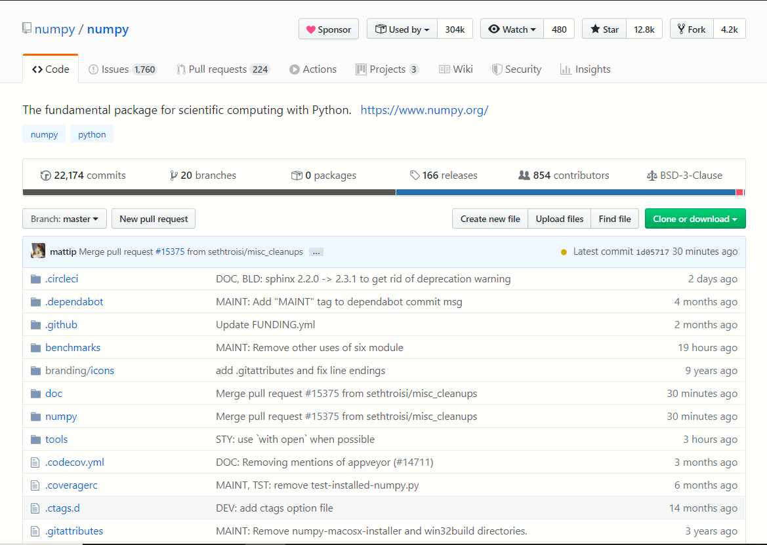
Example of a repository
Numpy: https://github.com/numpy/numpy
GitHub provides many tools for managing repositories
Repositories are created and managed using Git.
Notes:
Pandas codebase:
https://github.com/pandas-dev/pandas

Slide 7
What is Git?
Git is the most commonly used Version Control System (VCS)
Tracks changes made to a repository
Create branches to work on different features
Allows collaboration between developers
Manage project using command line

Slide 8
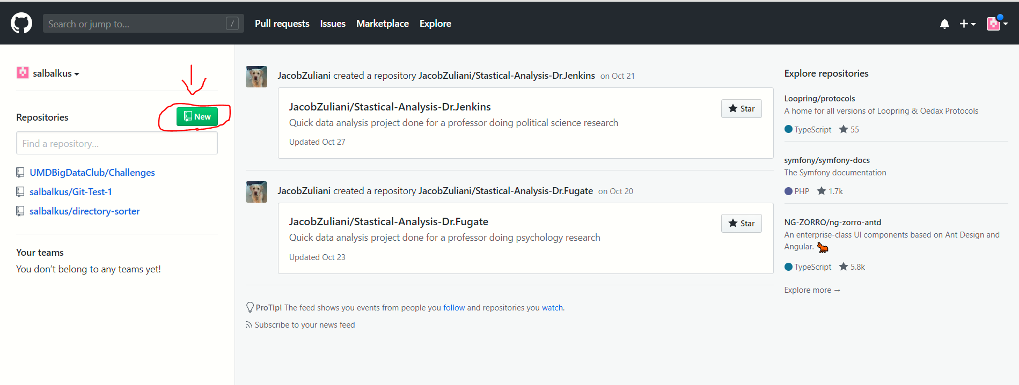
How do I set up my own repository on GitHub?
Create from GitHub (Recommended Method)
First, go to your dashboard and select “new”

Slide 9
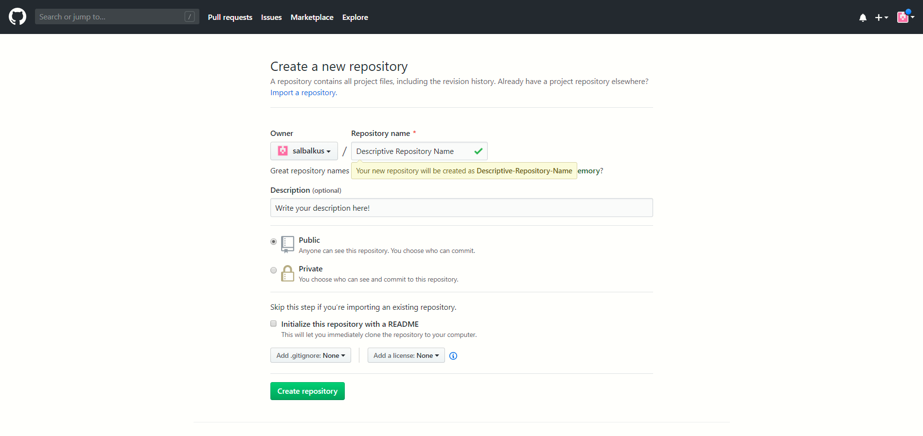
How do I set up my own repository on GitHub?
Create from GitHub
Next, fill out the required details

Slide 10
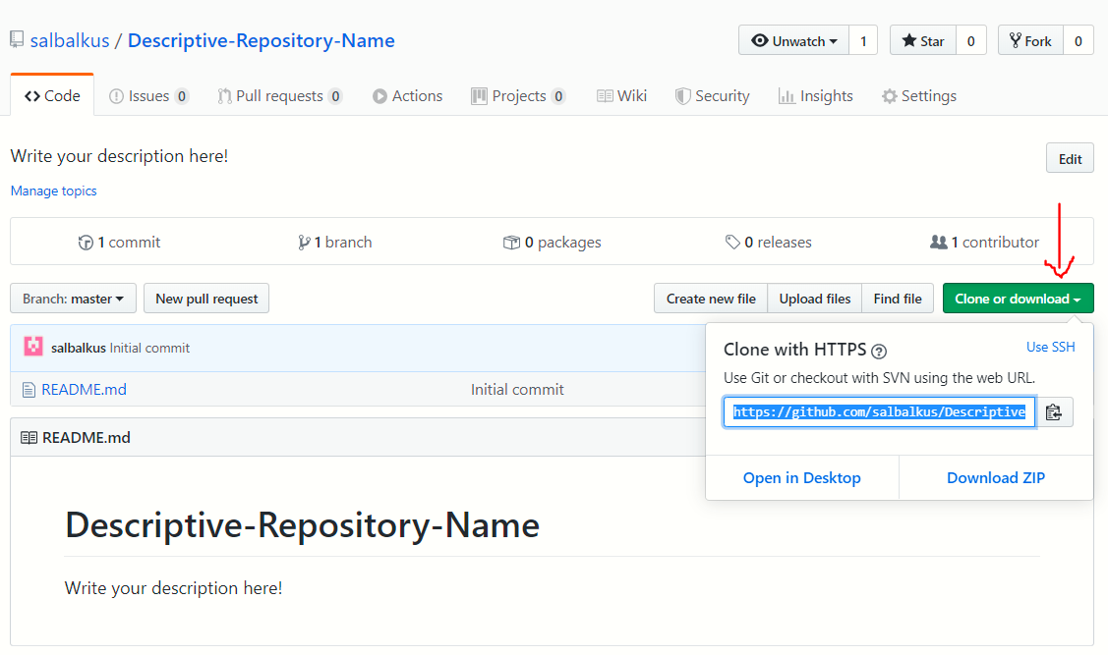
How do I set up my own repository on GitHub?
Create from GitHub
Click “clone or download” to obtain URL
Navigate to where you want the repository to be stored locally and run the command
git clone “url”
Can also clone a team’s repository

Slide 11
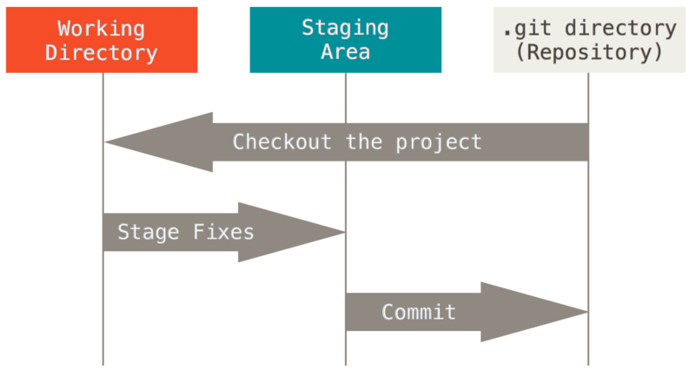
How does Git track changes?
Git File Stages (Three Types):
Git stores changes to a repository as snapshots
serves as a “mini filesystem”
entire project stored locally in .git directory
Adding to repository called “committing”
Notes:
https://git-scm.com/book/en/v2/Getting-Started-What-is-Git%3F
working directory is just a normal folder on your computer
staging area is a file that contains information about the commit
.git directory is the actual repository that tracks all of the files

Slide 12
The Git Workflow
When you make changes to your project locally, you update your remote repository with three commands:
git add “filename” OR git add “foldername” → tells Git that this is the part of your local work that you want to update (staging)
git commit -m “commit message” → commits the changes you have staged
git push → push the local commits to the remote repository
Notes:
add tree

Slide 13
Obtaining remote changes
If others add changes to the remote repository, you will need to update your own.
git pull → commit remote changes after your own (do not use if you have uncommitted changes)
git pull --rebase → takes remote changes and commits BEFORE your own; ensures your changes are committed after
git fetch → only updates repository, not working files; use to avoid overwriting your changes
Notes:
https://www.git-tower.com/learn/git/faq/difference-between-git-fetch-git-pull

Slide 14
Diagnostic Commands
Useful commands for tracking repository
git status → provides some information about the changes currently staged
git diff → shows difference between remote and your own
git --help → lists all available git commands in case you forget
Git provides a vast array of tools to manage repositories and track changes; if there is something specific you want to do, search the documentation.
Notes:
https://git-scm.com/docs/git-reset
https://www.freecodecamp.org/news/how-to-undo-changes-in-git-e1da7930afdb/

Slide 15
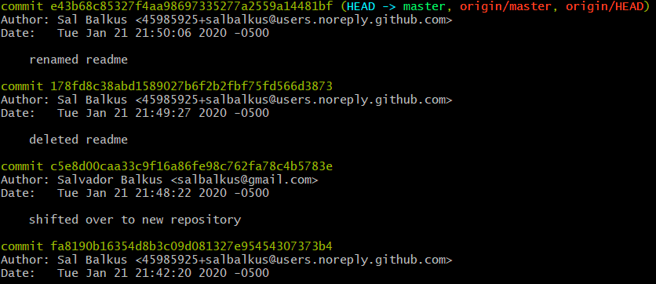
Accessing Past Changes
Using Git, you can examine commits that have been made and work with them.
git log → displays commits
git checkout “commit” → access files from a previous commit
git checkout -- “file name” → obtain old version of a specific file
git tag “tag name” → labels a commit so you can access it more easily
Notes:
https://www.git-tower.com/learn/git/faq/difference-between-git-fetch-git-pull
press Q to exit git log
To see all tracked files, use
git ls-tree --full-tree -r --name-only HEAD

Slide 16
Resetting Changes
Git provides many options for resetting changes:
git rm “file name” -f → remove a file from both working directory and repo
git rm “file name” --cached → remove a file from just repo
git reset --hard “commit” → roll back repository to the given commit
git revert “commit” -m “message” → re-commit a previous commit; use to target a specific commit to reset
Keep in mind resetting repository will not necessarily update working directory
Notes:
https://www.git-tower.com/learn/git/faq/difference-between-git-fetch-git-pull
https://www.atlassian.com/git/tutorials/undoing-changes/git-revert

Slide 17
Git: Branching
Suppose you want to develop or test a part of code separately and not have to worry about breaking existing code. This requires the use of branching.
git checkout -b “branch name” → creates a new “branch” where changes will not affect the master branch
git checkout “branch name” → switch to an existing branch
git branch → lists current branches
Notes:
Image: https://docs.microsoft.com/en-us/azure/devops/repos/git/git-branching-guidance?view=azure-devops
Deleting a branch: git branch -d <branch>

Slide 18
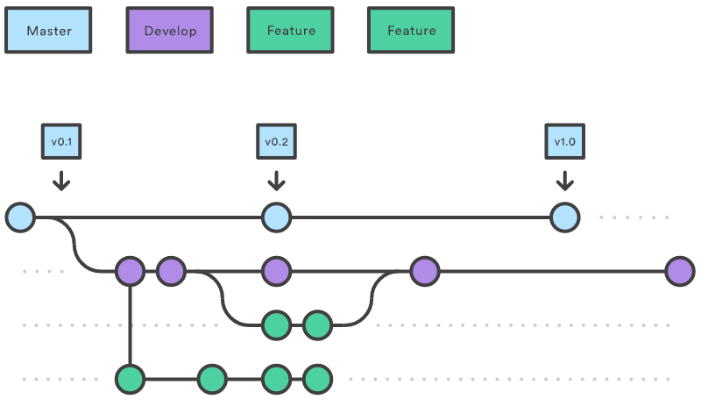
Git: Branching

Slide 19
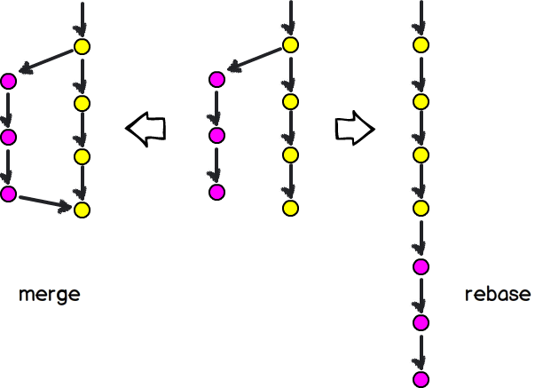
Git: Branching
Once you’ve finalized the code you are working on,
you will want to combine the branch with master.
git merge “branch name” → merges the specified branch with the branch you are currently on.
git rebase “branch name” → moves the specified branch to the end of another branch.
Notes:
Image: https://docs.microsoft.com/en-us/azure/devops/repos/git/git-branching-guidance?view=azure-devops
https://www.atlassian.com/git/tutorials/rewriting-history/git-rebase
Deleting a branch: git branch -d <branch>

Slide 20

Other Notes About Git
In addition to the commands discussed, Git offers a variety of tools for managing repositories and branches. Please see the documentation:
https://git-scm.com/doc
Most of your work will consist of add, commit, push
branches used for large projects with different features OR collaboration
do not push directly to master! (in general)

Slide 21
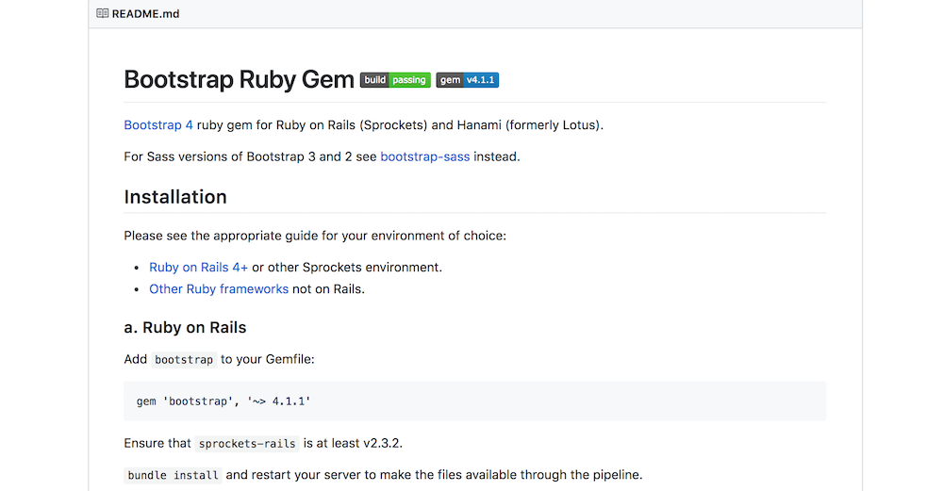
Some good practices
Include a README and other text files
explain purpose of project, contributors, how to use, etc.
Consider including a license (see repo settings)
MIT license - allows reuse with citation, but retains your copyright
Avoid pushing private data, changing files, or “auxiliary” files to repo
Data generally not pushed; excessive storage, may change
Do not want files specific to your machine (ex: .pynb checkpoints)
use .gitignore file
Notes:
https://en.wikipedia.org/wiki/MIT_License

Slide 22

.gitignore File
Defines what will NOT be pushed to the git repository:
byproduct/auxiliary files; these are specific to your machine
Data files that you do not want to push
LaTeX intermediates
Uses patterns to define what files NOT to add; see how to define: https://git-scm.com/docs/gitignore
Or copy one from a compilation: https://github.com/github/gitignore
Notes:
Ex. use the python .gitignore

Slide 23

Open Source Project Models
Shared Repository: Administrators explicitly designate certain individuals or teams as contributors
Can give different individuals different access (read, write, admin)
Fork and Pull: allows anyone to contribute to a project
Individuals “fork” a copy of the project and work in their individual fork
Puts the repository on your account
Suggest additions via pull request
Allows you to contribute to open-source projects!
Notes:
https://help.github.com/en/desktop/contributing-to-projects/creating-a-pull-request

Slide 24
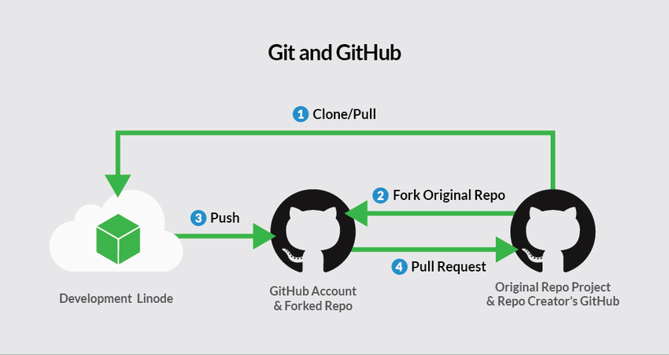
How to make a pull request
Pull request: used to recommend and discuss changes
Request merging a side branch with “upstream” branch such as master
Shows differences between branches
Administrators can require pull requests to be reviewed
GitHub “pull requests” menu provides options for managing pull requests
Gives users space to discuss changes
Once discussion complete, branches merged by admin
Notes:
https://help.github.com/en/github/collaborating-with-issues-and-pull-requests/about-pull-requests
Image: https://www.researchgate.net/figure/Git-with-GitHub-Workflows_fig1_318912754

Slide 25
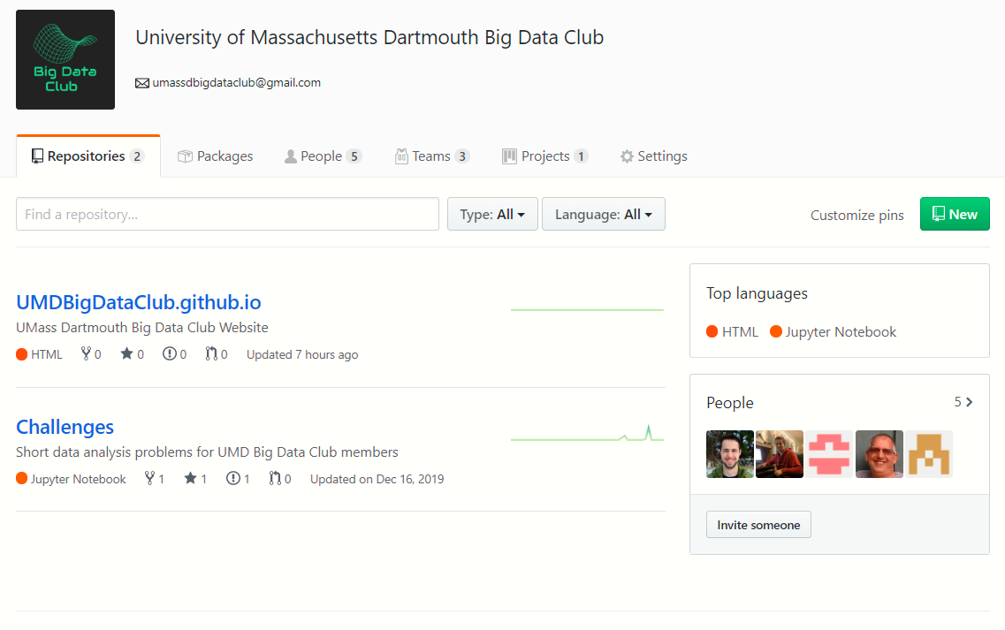
Organizations
Example: UMD Big Data Club
https://github.com/UMDBigDataClub
Organizations facilitate collaboration on GitHub
Set up teams and projects to assign tasks
Can create repos under the organization

Slide 26

The Social Media Aspect
GitHub provides a variety of ways to interact with other users
Watch repositories to be notified of updates
Star repositories you find useful
Follow other users to be notified of their activities
Create static websites using GitHub Pages
Your profile tracks where you are contributing, how often, and the statistics for your repositories you have created or forked

Slide 27


Other GitHub Features
GitHub offers many additional tools to manage repositories, including…
Automation - set up “Actions” to manage repository and contributors automatically
Webhooks - notify services when events occur
Issue Tracking - allow others to report bugs
Wikis - provide additional documentation
Notes:
Images:
https://commons.wikimedia.org/wiki/File:Font_Awesome_5_brands_github.svg
https://pixabay.com/vectors/search/book%20cover/

Slide 28
Any questions?

